Slide 1





Data Science Salary Insights
Exploring earning potential trends

Slide 2

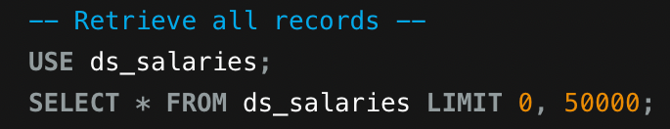
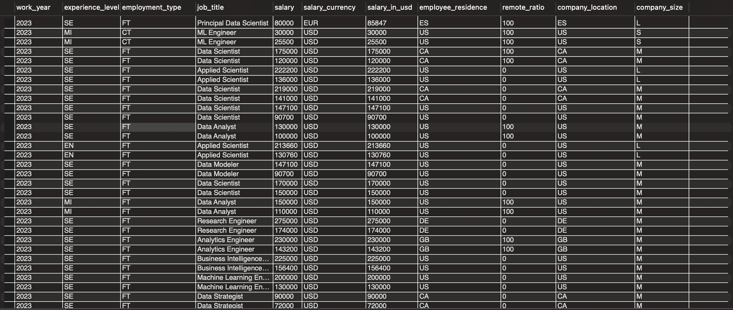
SELECT * FROM ds_salaries
Retrieve all records
Salary Insights

Slide 3
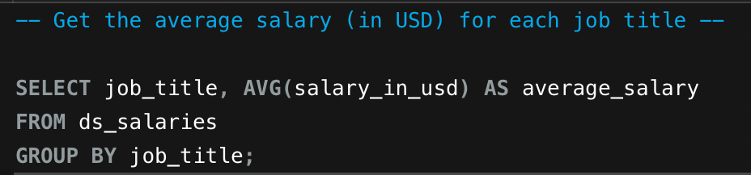
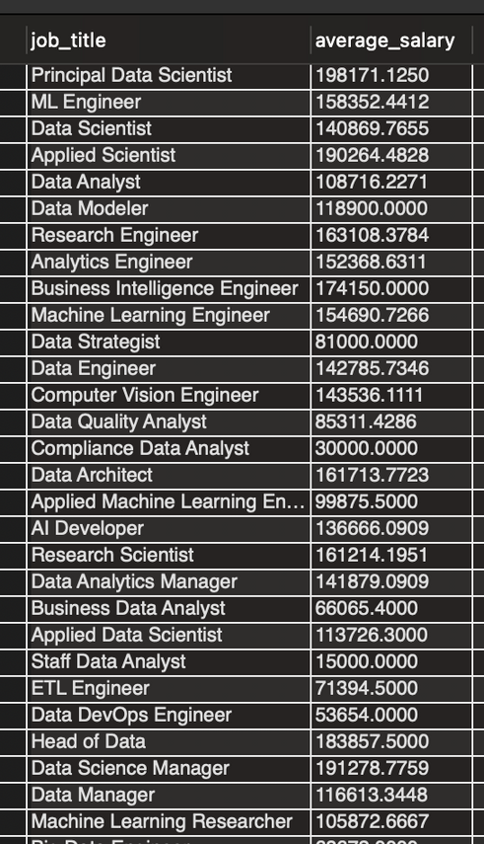
SELECT job_title, AVG(salary_in_usd) AS average_salary
FROM ds_salaries
GROUP BY job_title;
Get the average salary (in USD) for each job title

Slide 4
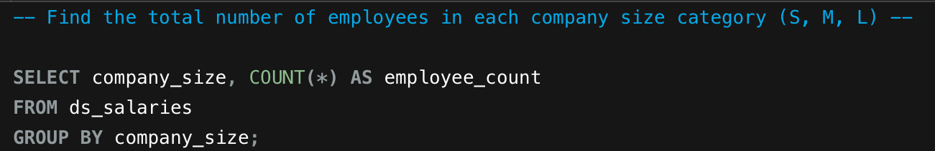
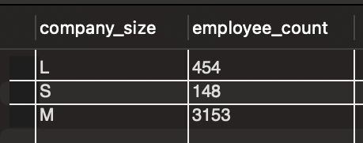

Salary Trends
SELECT company_size, COUNT(*) AS employee_count
FROM ds_salaries
GROUP BY company_size;
Find the total number of employees in each company size category (S, M, L)

Slide 5
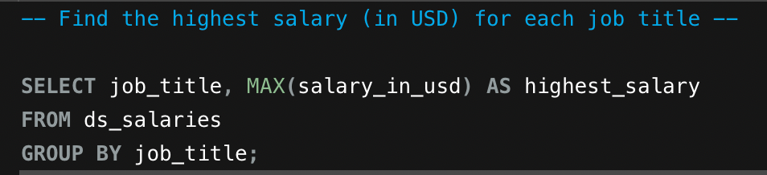
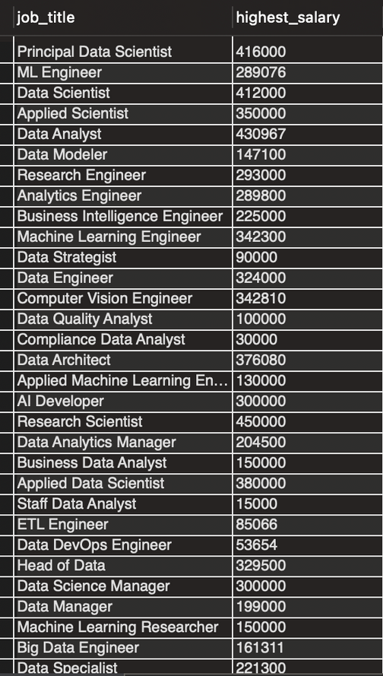
Salary Trends
SELECT job_title, MAX(salary_in_usd) AS highest_salary
FROM ds_salaries
GROUP BY job_title;
Find the highest salary (in USD) for each job title

Slide 6
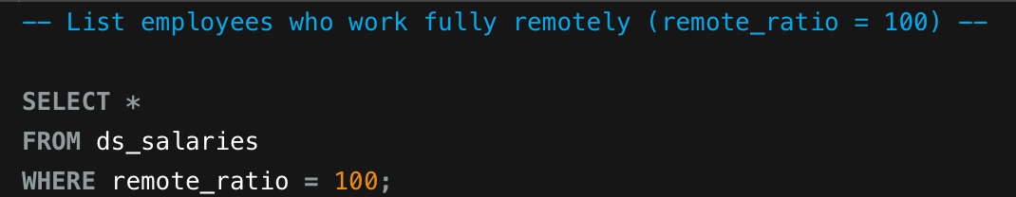
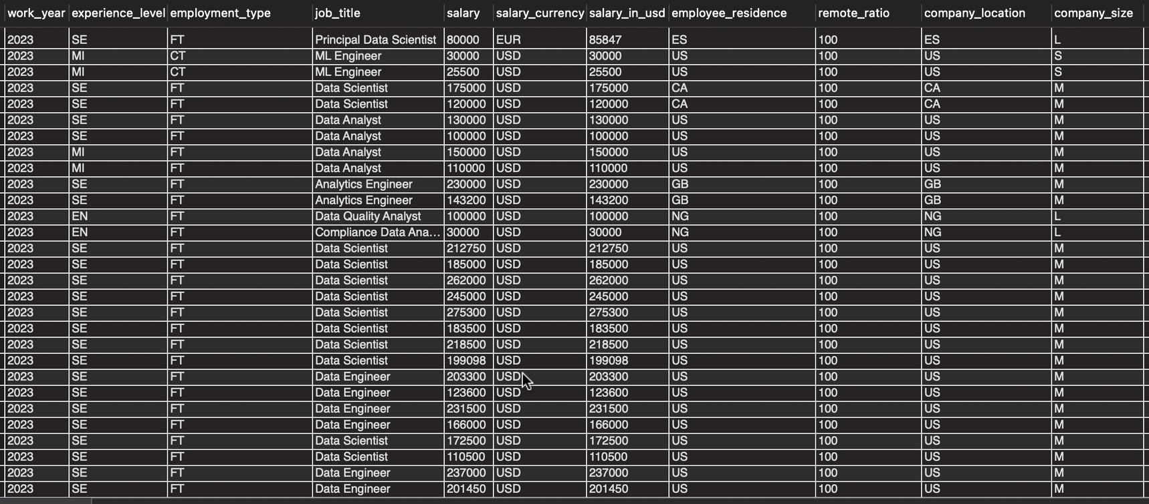
Salary Trends
SELECT *
FROM ds_salaries
WHERE remote_ratio = 100;
List employees who work fully remotely (remote_ratio = 100)

Slide 7
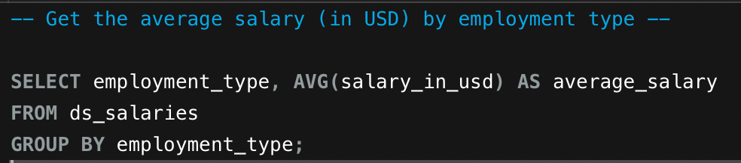
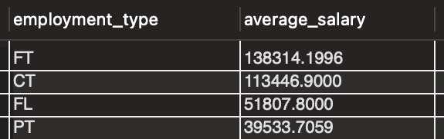
Salary Trends
SELECT employment_type, AVG(salary_in_usd) AS average_salary
FROM ds_salaries
GROUP BY employment_type;
Get the average salary (in USD) by employment type

Slide 8
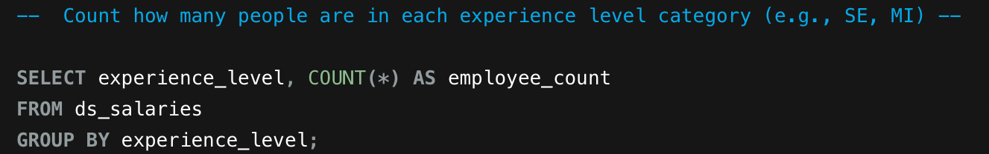
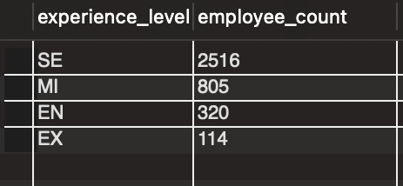
Salary Trends
SELECT experience_level, COUNT(*) AS employee_count
FROM ds_salaries
GROUP BY experience_level;
Count how many people are in each experience level category (e.g., SE, MI)

Slide 9
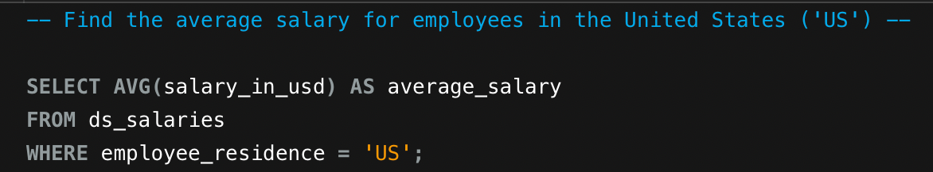
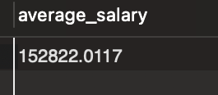
Salary Trends
SELECT AVG(salary_in_usd) AS average_salary
FROM ds_salaries
WHERE employee_residence = 'US';
Find the average salary for employees in the United States ('US')

Slide 10
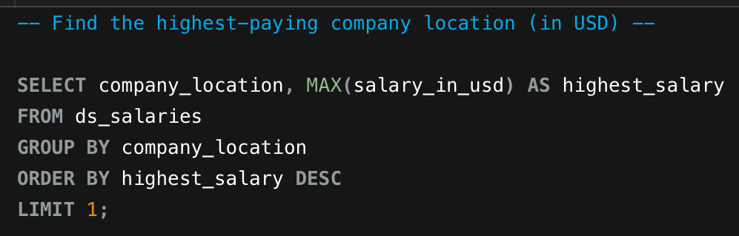
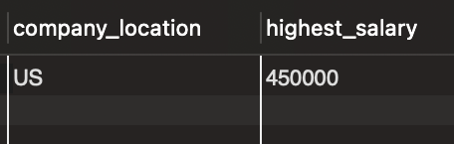
Salary Trends
SELECT company_location, MAX(salary_in_usd) AS highest_salary
FROM ds_salaries
GROUP BY company_location
ORDER BY highest_salary DESC
LIMIT 1;
Find the highest-paying company location (in USD)

Slide 11
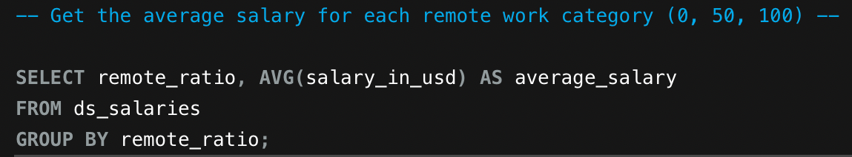
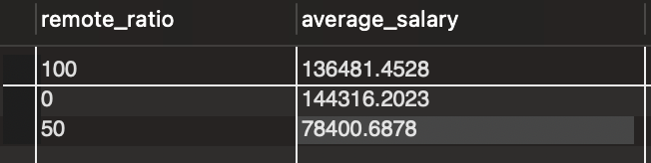
Salary Trends
SELECT remote_ratio, AVG(salary_in_usd) AS average_salary
FROM ds_salaries
GROUP BY remote_ratio;
Get the average salary for each remote work category (0, 50, 100)

Slide 12
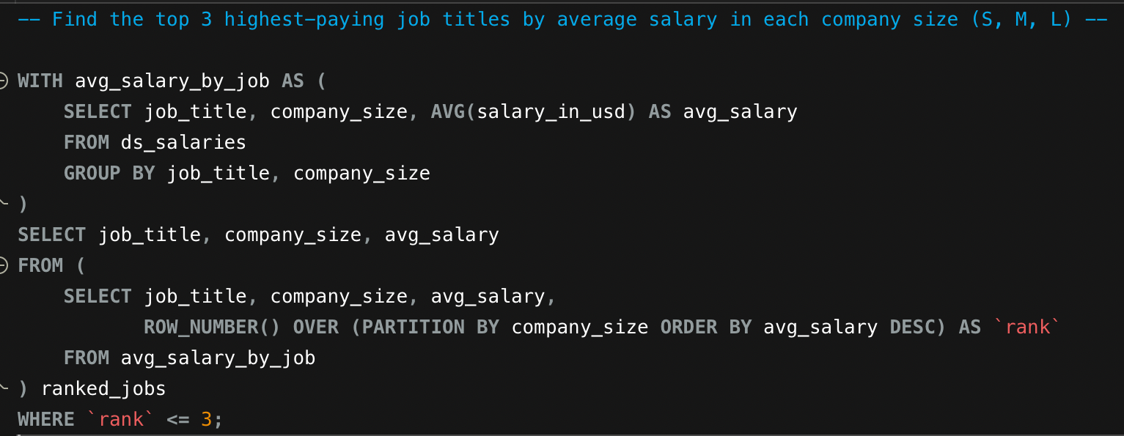
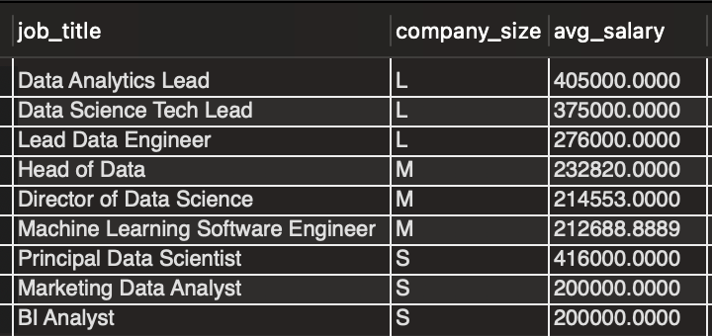
Salary Trends
WITH avg_salary_by_job AS (
SELECT job_title, company_size, AVG(salary_in_usd) AS avg_salary
FROM ds_salaries
GROUP BY job_title, company_size
)
SELECT job_title, company_size, avg_salary
FROM (
SELECT job_title, company_size, avg_salary,
ROW_NUMBER() OVER (PARTITION BY company_size ORDER BY avg_salary DESC) AS `rank`
FROM avg_salary_by_job
) ranked_jobs
WHERE `rank` <= 3;
Find the top 3 highest-paying job titles by average salary in each company size (S, M, L)

Slide 13
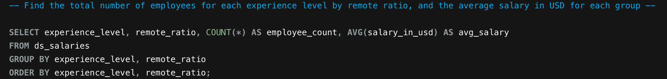
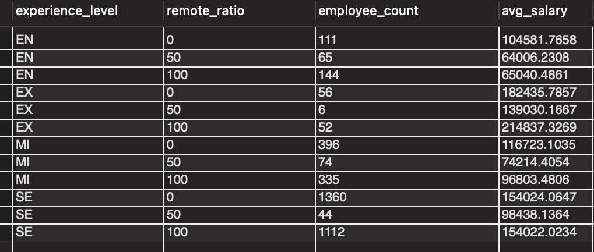
Salary Trends
SELECT experience_level, remote_ratio, COUNT(*) AS employee_count, AVG(salary_in_usd) AS avg_salary
FROM ds_salaries
GROUP BY experience_level, remote_ratio
ORDER BY experience_level, remote_ratio;
Find the total number of employees for each experience level by remote ratio, and the average salary in USD for each group

Slide 14
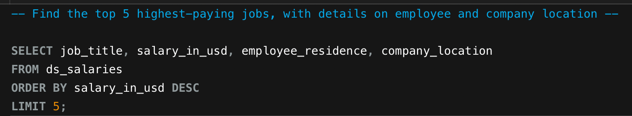
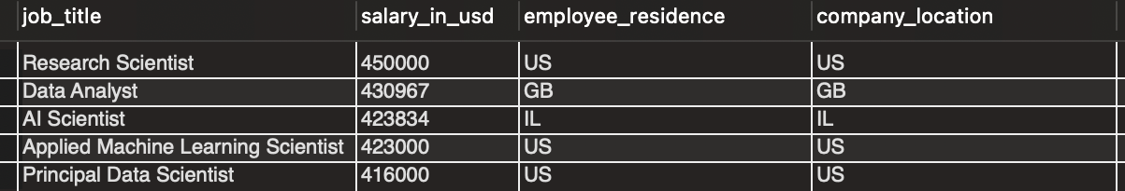
Salary Trends
SELECT job_title, salary_in_usd, employee_residence, company_location
FROM ds_salaries
ORDER BY salary_in_usd DESC
LIMIT 5;
Find the top 5 highest-paying jobs, with details on employee and company location

Slide 15
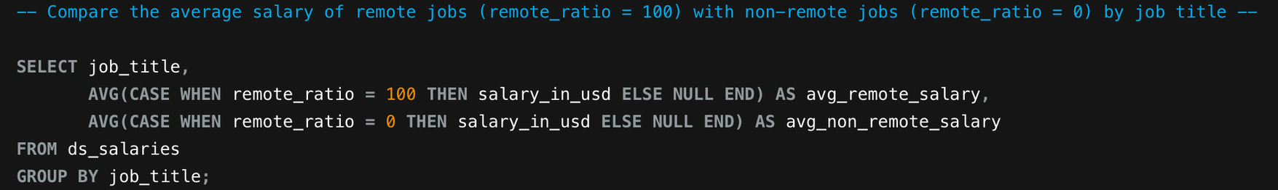
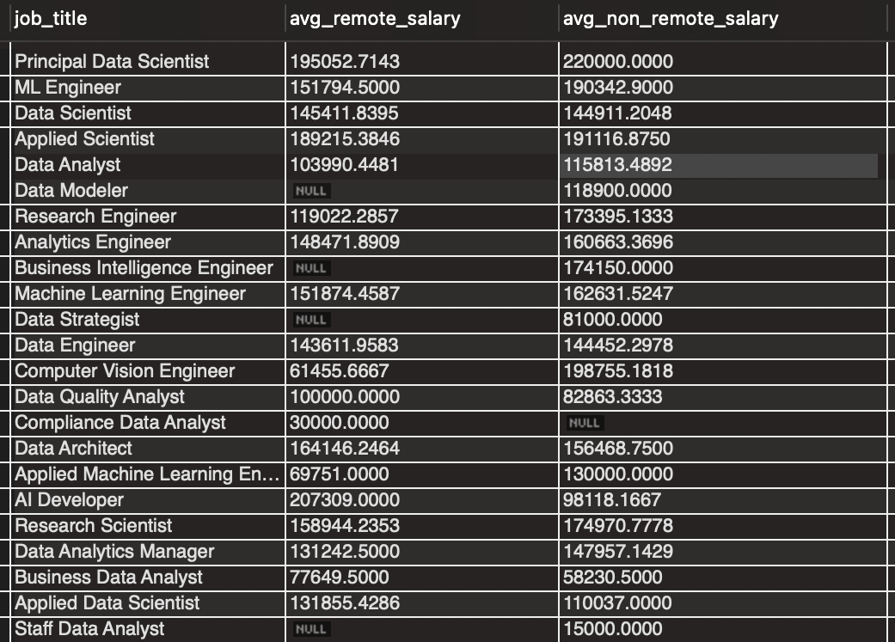
Salary Trends
SELECT job_title,
AVG(CASE WHEN remote_ratio = 100 THEN salary_in_usd ELSE NULL END) AS avg_remote_salary,
AVG(CASE WHEN remote_ratio = 0 THEN salary_in_usd ELSE NULL END) AS avg_non_remote_salary
FROM ds_salaries
GROUP BY job_title;
Compare the average salary of remote jobs (remote_ratio = 100) with non-remote jobs (remote_ratio = 0) by job title

Slide 16
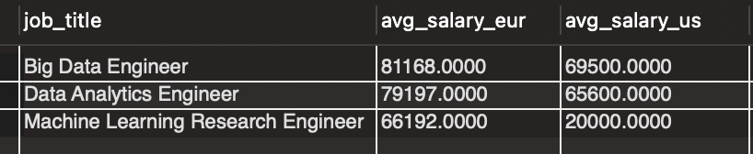
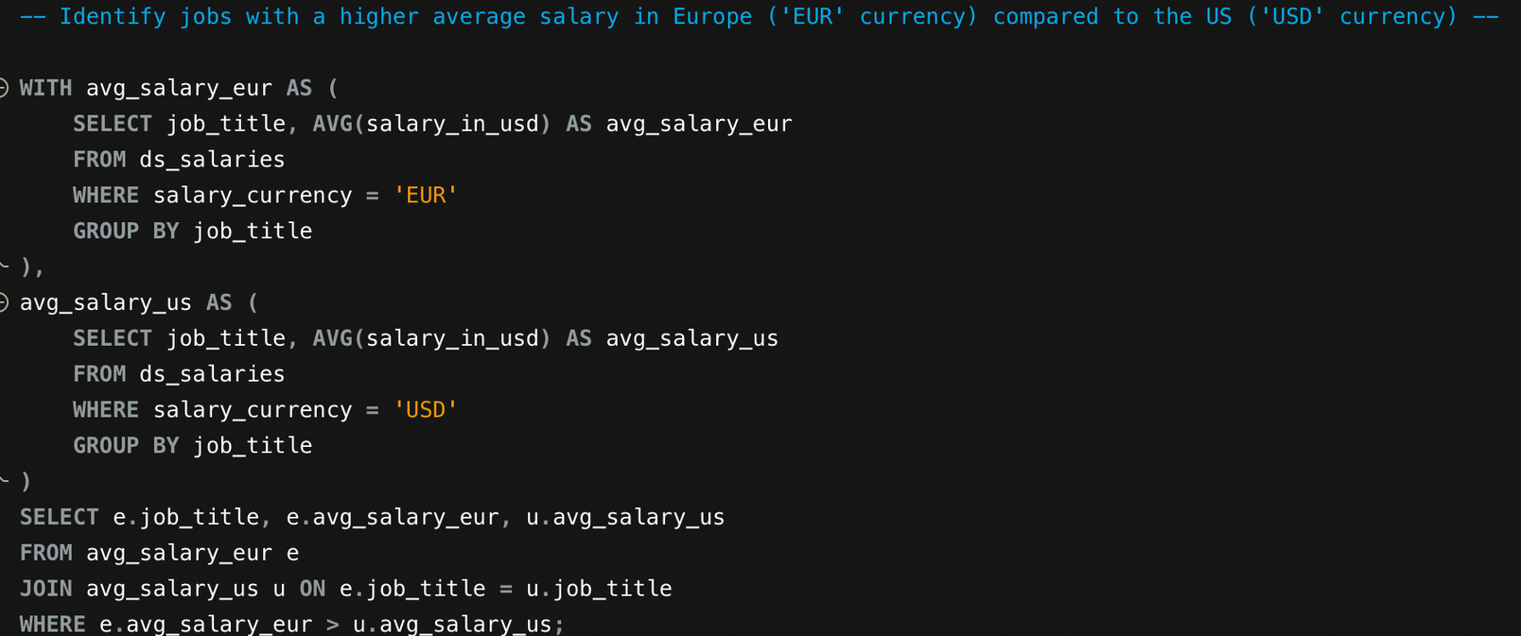
Salary Trends
WITH avg_salary_eur AS (
SELECT job_title, AVG(salary_in_usd) AS avg_salary_eur
FROM ds_salaries
WHERE salary_currency = 'EUR'
GROUP BY job_title
),
avg_salary_us AS (
SELECT job_title, AVG(salary_in_usd) AS avg_salary_us
FROM ds_salaries
WHERE salary_currency = 'USD'
GROUP BY job_title
)
SELECT e.job_title, e.avg_salary_eur, u.avg_salary_us
FROM avg_salary_eur e
JOIN avg_salary_us u ON e.job_title = u.job_title
WHERE e.avg_salary_eur > u.avg_salary_us;
Identify jobs with a higher average salary in Europe ('EUR' currency) compared to the US ('USD' currency)

Slide 17
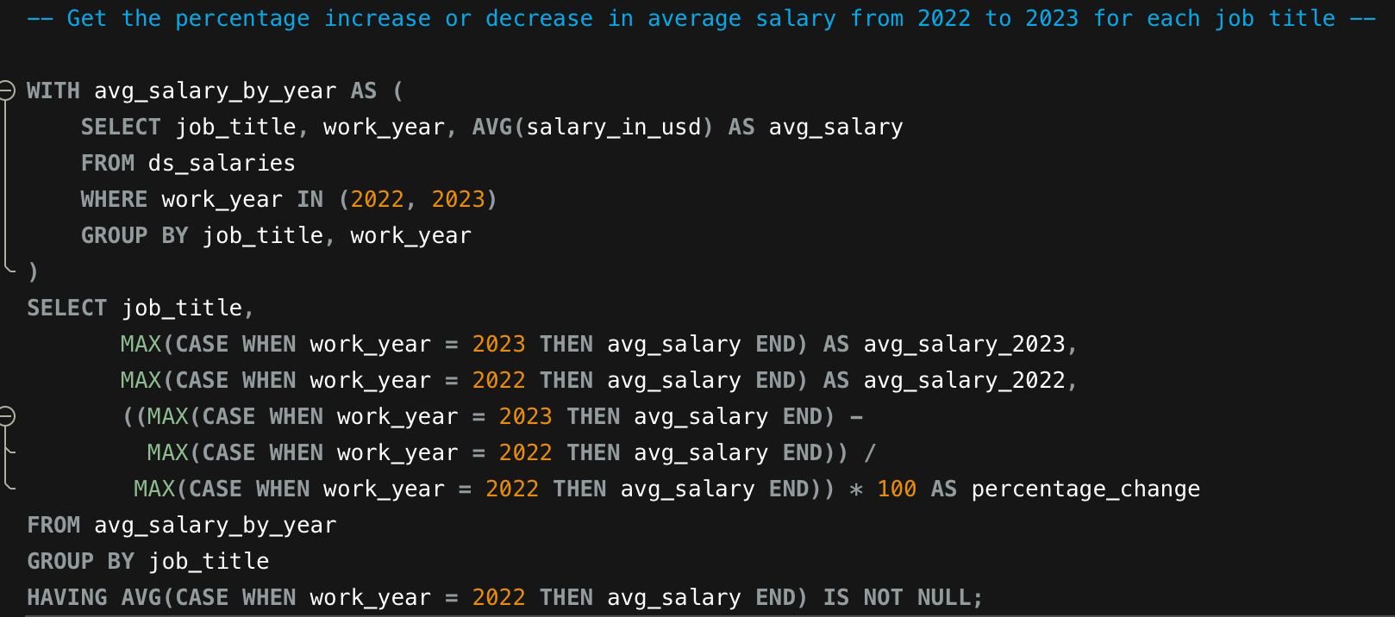
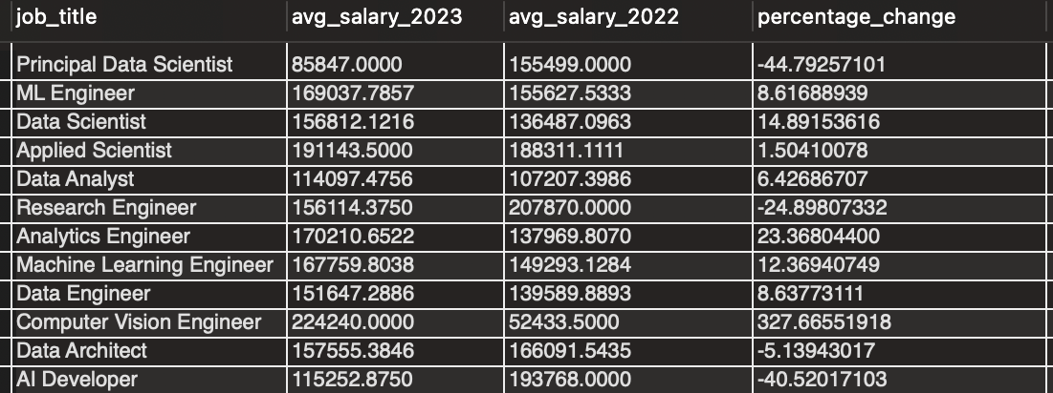
Salary Trends
WITH avg_salary_by_year AS (
SELECT job_title, work_year, AVG(salary_in_usd) AS avg_salary
FROM ds_salaries
WHERE work_year IN (2022, 2023)
GROUP BY job_title, work_year
)
SELECT job_title,
MAX(CASE WHEN work_year = 2023 THEN avg_salary END) AS avg_salary_2023,
MAX(CASE WHEN work_year = 2022 THEN avg_salary END) AS avg_salary_2022,
((MAX(CASE WHEN work_year = 2023 THEN avg_salary END) -
MAX(CASE WHEN work_year = 2022 THEN avg_salary END)) /
MAX(CASE WHEN work_year = 2022 THEN avg_salary END)) * 100 AS percentage_change
FROM avg_salary_by_year
GROUP BY job_title
HAVING AVG(CASE WHEN work_year = 2022 THEN avg_salary END) IS NOT NULL;
Get the percentage increase or decrease in average salary from 2022 to 2023 for each job title

Slide 18
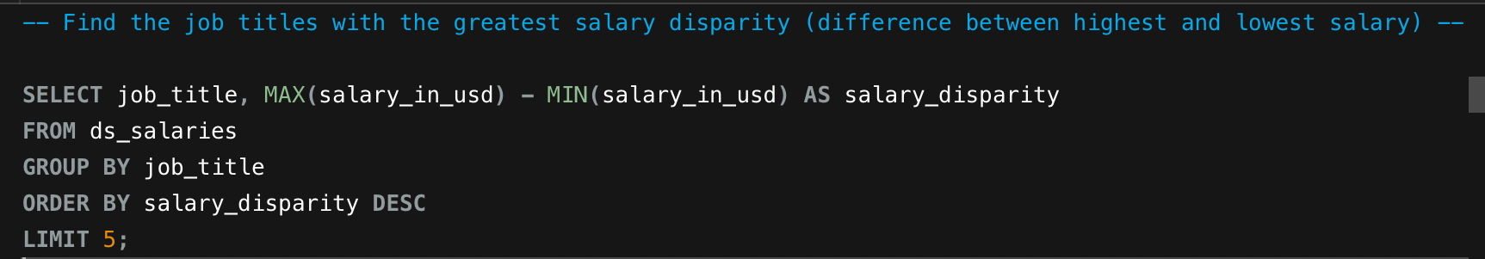
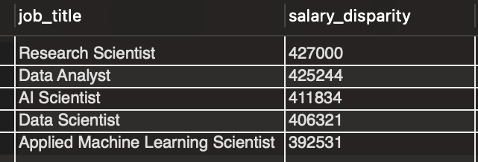
Salary Trends
SELECT job_title, MAX(salary_in_usd) - MIN(salary_in_usd) AS salary_disparity
FROM ds_salaries
GROUP BY job_title
ORDER BY salary_disparity DESC
LIMIT 5;
Find the job titles with the greatest salary disparity (difference between highest and lowest salary)

Slide 19
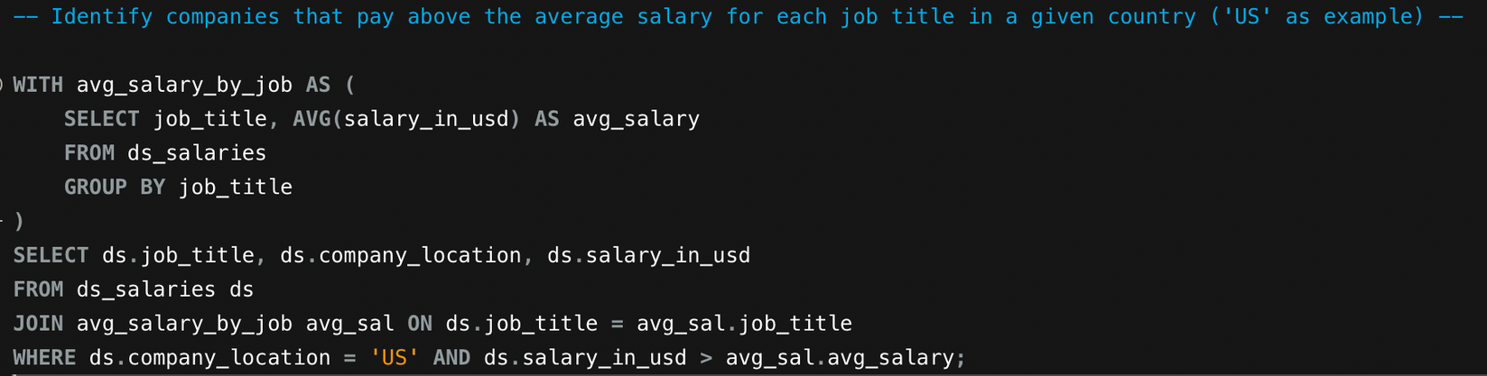
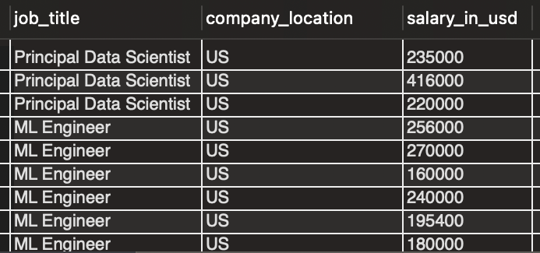
Salary Trends
WITH avg_salary_by_job AS (
SELECT job_title, AVG(salary_in_usd) AS avg_salary
FROM ds_salaries
GROUP BY job_title
)
SELECT ds.job_title, ds.company_location, ds.salary_in_usd
FROM ds_salaries ds
JOIN avg_salary_by_job avg_sal ON ds.job_title = avg_sal.job_title
WHERE ds.company_location = 'US' AND ds.salary_in_usd > avg_sal.avg_salary;
Identify companies that pay above the average salary for each job title in a given country ('US' as example)

Slide 20
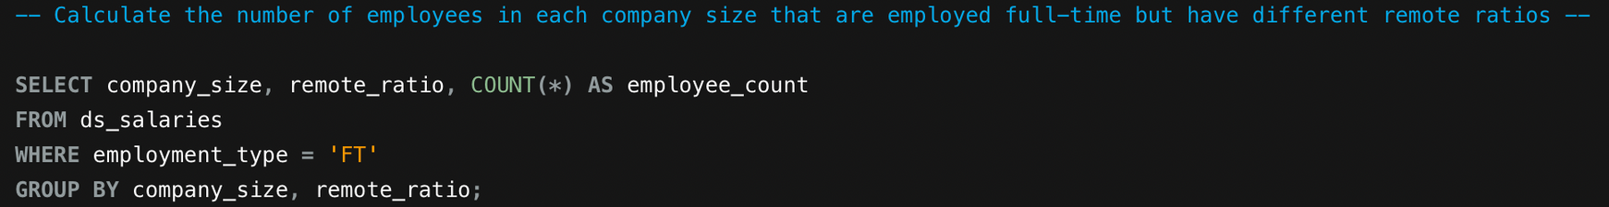
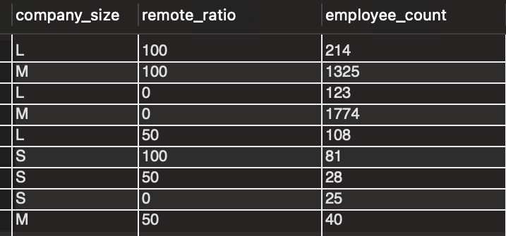
Salary Trends
SELECT company_size, remote_ratio, COUNT(*) AS employee_count
FROM ds_salaries
WHERE employment_type = 'FT'
GROUP BY company_size, remote_ratio;
Calculate the number of employees in each company size that are employed full-time but have different remote ratios

Slide 21
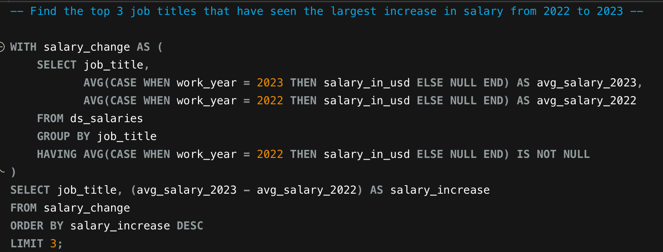
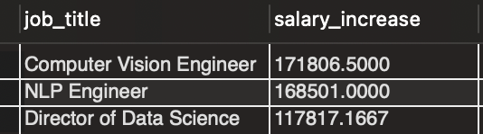
Salary Trends
WITH salary_change AS (
SELECT job_title,
AVG(CASE WHEN work_year = 2023 THEN salary_in_usd ELSE NULL END) AS avg_salary_2023,
AVG(CASE WHEN work_year = 2022 THEN salary_in_usd ELSE NULL END) AS avg_salary_2022
FROM ds_salaries
GROUP BY job_title
HAVING AVG(CASE WHEN work_year = 2022 THEN salary_in_usd ELSE NULL END) IS NOT NULL
)
SELECT job_title, (avg_salary_2023 - avg_salary_2022) AS salary_increase
FROM salary_change
ORDER BY salary_increase DESC
LIMIT 3;
Find the top 3 job titles that have seen the largest increase in salary from 2022 to 2023

Slide 22
INDUSTRY TRENDS AND INSIGHTS
SKILLS AND QUALIFICATIONS REQUIRED
Data Science Salary Overview Today
Data science salaries are increasing rapidly today.
Highly specialized skills lead to higher salaries overall.
Explore current trends in data science salary expectations.
JOB MARKET DEMAND ANALYSIS
SALARY EXPECTATIONS FOR ROLES
Growing demand creates more job opportunities now.
Understanding salary ranges helps in career planning.

Slide 23
Salary Insights
Exploring Data Science Salary Trends
MARKET DEMAND
SKILL DEVELOPMENT
CAREER GROWTH
FUTURE OF CAREERS
High demand leads to competitive salary packages offered.
Continuous learning is essential for keeping up with trends.
Salaries vary widely based on experience and location.
Data Science offers great opportunities for growth.

Slide 24
Thank You
Data Science Salary Overview Today
BY - JAYENT SINGH PARIHAR
Explore current trends in data science salary expectations.

